Slide 1
Reel returns: Machine learning insight into movie profitability
PROJECT II
Solve, analyze, or visualize a problem using machine learning (ML)
Use either a supervised or unsupervised ML model
Evaluate the trained model(s) using testing data
Utilize Scikit-learn
Leverage at least 3 of the below:
API requests
Matplotlib
Pandas
Pandas plotting
Prophet
Python
Time series analysis
AI Engineering Bootcamp Project II Group 10 | July 2024

Slide 2












AGENDA
OVERVIEW
APPROACH
FINDINGS
FUTURE CONSIDERATIONS

Slide 3










team: pii-G10
Do fun titles w/rolling credits if possible
Director
Audio engineer
Gaffer
Film editor
Grips
Sound mixer
Location manager
Production manager
Actor
Producer
Cinematographer
Production designer
Stunt coordinator
“Never send a human to do a machine’s job.” The Matrix (1999)
Eric Alicea
Kalvin Anglin
Vadim Bychok
Peta Mckenzie
Odele Pax
Funda Subasi
Stunt Coordinator
Producer
Actor
Film Editor
Director
Gaffer
Notes:
Dividing the work based on interest, skillset, and interest

Slide 4




purpose
“What is the most resilient parasite? Bacteria? A virus? An intestinal worm? An idea. Resilient … highly contagious. An idea that is fully formed – fully understood – that sticks.” Inception (2010)
This project aims to predict the profitability of movies released in the United States from 1981 – 2023 using various machine learning techniques. Analyze key variables such as genre, budget, revenue, ratings and economic indicators to identify patterns and factors that significantly impact movie performance.

Slide 5
Overview
DATASET:
Movies: via TMDB Movies Daily Update (1981 to 2023)
Economics: via Kaggle, epi.org: Consumer Confidence Indicator (CCI) and Consumer Price Index (CPI), Unemployment Rate
LIBRARIES:
Leverage Scikit-learn, Matplotlib, Pandas, Pandas plotting, Python
GOALS | PROBLEMS TO SOLVE
Predict Movie Performance: Develop a machine learning model to predict profitably Analyze Economic Impact: Investigate how economic conditions influence movie performance Feature Engineering: Identify/create meaningful features from raw data to improve accuracy Model Evaluation: Assess the performance of different machine learning models to determine best approach for predicting movie profitability | Data Quality and Imputation: Address missing and inconsistent data in the dataset Model Selection: Choose the most effective machine learning algorithms for prediction Economic Correlation: Quantify relationship between economic indicators and movie performance Scalability: Ensure the model can handle the large datasets and provide real time predictions
Notes:
Consider adding feature selection in future considerations

Slide 6


Data collection, cleaning, & exploration
“We do not follow maps to buried treasure, and X never, ever marks the spot.” Indiana Jones and the Last Crusade (1989)
EDA
Merge Datasets
Train-Test-Split
Scaling
Encoding
Modeling & Evaluation
Insights & Reporting
Notes:
Data Collection and Cleaning: Gather data from multiple sources, clean it to remove inaccuracies and handle missing values.
Exploratory Data Analysis (EDA): Visualize and understand data distributions and relationships between key variables.
Understanding the data without a SME (economist)
Selecting which economic datasets to use
How to get the monthly reporting to connect to individually released movies
How genres are classified - initial challenges with what to do with the null records
Merging Datasets: Combine different datasets to create a comprehensive dataset with all necessary features.
Train-Test Split: Divide the data into training and testing sets to evaluate model performance.
Scaling: Normalize numerical features to ensure consistent ranges.
Encoding: Convert categorical variables into numerical formats for the model to process.
Had to switch encoder from One hot to label encoder. Saw poor performance using One Hot and then switched to course correct. Switching to label encoding simplified the model and reduced computational complexity, especially with high-cardinality categorical features.
High Cardinality: One-hot encoding can create too many columns if there are many unique categories. Label encoding reduces the dimensionality by converting categories into numerical labels.
Ordinal Nature: If the categories have a natural order (e.g., low, medium, high), label encoding preserves this order, while one-hot encoding does not
Modeling: Build and train machine learning models (e.g., linear regression, decision trees, KNN).
Evaluation and Tuning: Assess model performance using metrics like precision, recall, MSE, and R². Fine-tune models to improve accuracy.
Level of confidence with the outcome of some of the models
Insights and Reporting: Extract and present insights on which factors most influence movie profitability and the model's predictive power.

Slide 7
Approach
Success Conditions is a concatenation of three classes: critical success(Ratings ), financial success (ROI), and economic indicators(CCI,CPI,& UR)
The purpose of this approach is to understand the relationship between these variables to be able to propose the optimal time to release a movie,as well as outline potential trade-offs and manage expectations related to ROI when doing releases during sub-optimal times
Classifier Models : Logistic, Random Forrest, Decision Tree, ADA Booster. KNN. Linear Regression: Facilitates the ROI prediction
CRITICAL | FINANCIAL | ECONOMIC
 |  | Based off the rolling 12-month mean for each feature, we can look for a positive or negative change in values and flag the movement: For CCI, a positive change is "good", as it indicates an increase in the likelihood of consumers to spend money For CPI, a negative change is "good", as it indicates a decrease in the costs for goods and services For Unemployment Rate, a negative change is "good", as it indicates an increase in the population active in the workforce Therefore, we can interpret movement contrary to those changes as "bad". With this simplified view of the features, we can draw a classification as follows If at least two (2) features have a "good" value, we can set Economic Climate to Comfortable to Good If at least two (2) features have a "bad" value, we can set Economic Climate to Lean to Bad
Ratings | Critical Success
0 – 2.4 | Panned
2.5 – 4.9 | Alright
5.0 – 7.4 | Well Liked
7.5 – 10 | Successful
ROI (%) | Financial Success
< 0 | Failure
<= 50 | Modest Returns
<= 100 | Moderate Returns
<= 500 | Excellent Returns
> 500 | Extraordinary Returns
ROI: Return on Investment CCI: Consumer Confidence Index CPI: Consumer Price Index UR: Unemployment Rate
Notes:
Share more on journey:
Idea to add econ factor --- Identify key metrics in economics as another feature
Overcoming challenge with git/encoding/EDA
How we wrote our own classification for movie set and economics
Engineering the economic target variable: defining the ranges/classifications, created features to flag, applied indicators, created list of conditions
What we were able to prove ultimately with what level of accuracy– numeric correlation etc
Models
Logistic Regression (Peta)
Random Forrest (Vadim)
Linear Regression (Funda)
ADA Booster (Eric)
Decision Tree: TBD
KNN: Kalvin
*** KNN (understanding the scope of the data – it performed the worst give the size – large and multi-feature dataset – shot in the dark)
Other questions
Do some genres do well during certain economic climate
Separate targets out from the concatenated target and see the connections

Slide 8





Findings
“By law, the quest for ultimate truth is the inalienable prerogative of your working thinkers. And if the machine actually goes and finds it, we’re straight out of a job aren’t we?.” The Hitchhiker’s Guide to the Galaxy (2005)
There is no clear relationship between the economic factors (CCI, CPI, UR) and movie profitability/ROI
Some individual features like ‘Genre’ proved effective at predicting movie profitability
After running multiple models the relationships in our dataset were found to be best served by non-linear models
Random Forest was most effective, achieving 83% precision in classifying the Success Conditions variable
JULY 2024
Notes:
Key Findings
There is no clear relationship between the economic factors and movie profitability/ROI
We were able to achieve 85% precision in classifying the combined critical-financial- economic target variable using the Random forest model
Depending on the Linear Regression accuracy score that comes back from Funda’s code – it will tells us how accurate we were at predicting profitability (R-squared, MSE)

Slide 9
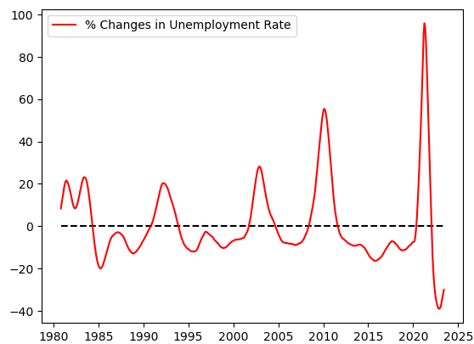
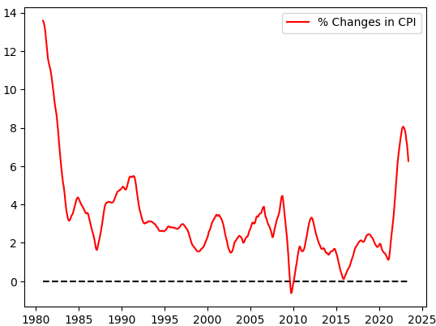
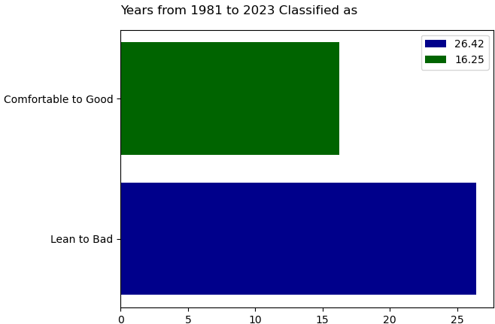
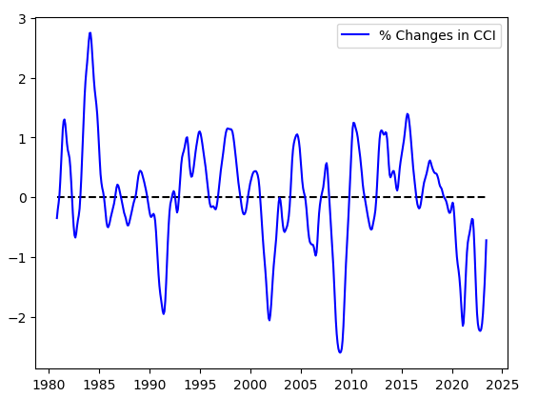
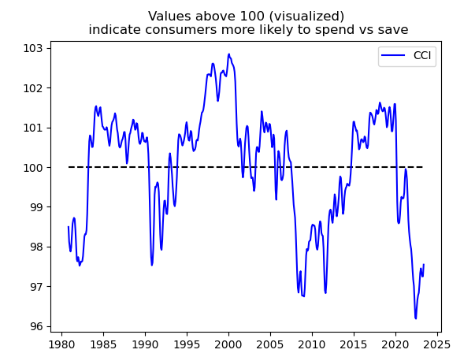
Economic outlook
THE PAST 40+ YEARS HAS BEEN MOSTLY ‘LEAN TO BAD’ ON THE ECONOMIC FRONT
ROI: Return on Investment CCI: Consumer Confidence Index CPI: Consumer Price Index UR: Unemployment Rate
Notes:
Key Findings
Things have mostly been lean to bad on the economic front over the past 25 years; particularly 2020 onwards (Covid years)
2020 onwards marked by high inflation (CPI) and unemployment (UR) and low/declining consumer confidence (CCI)
Note: Streaming revenue is part of the reasoning for why we retained the COVID years …

Slide 10
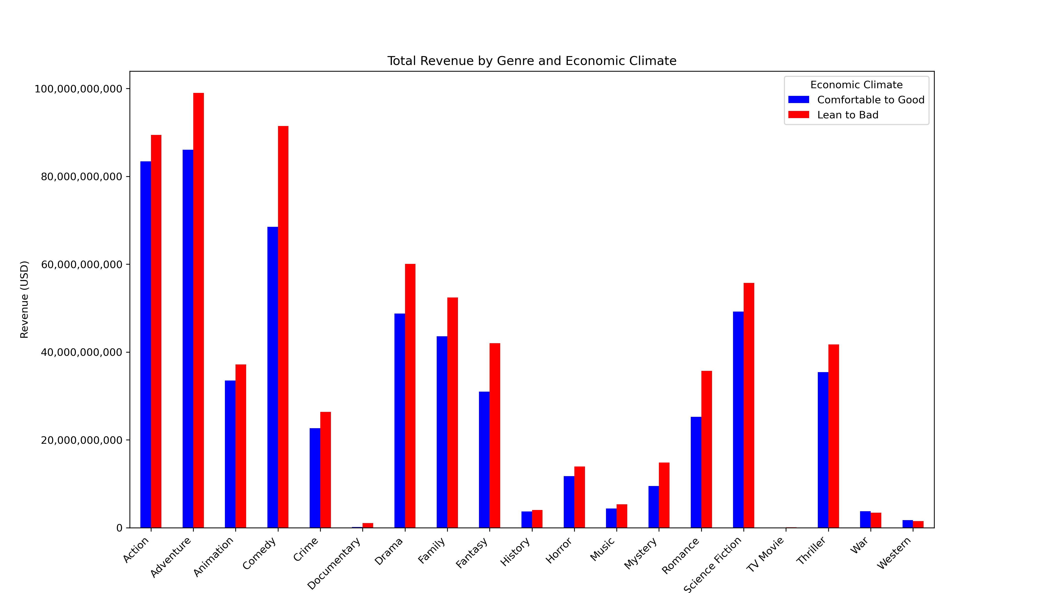
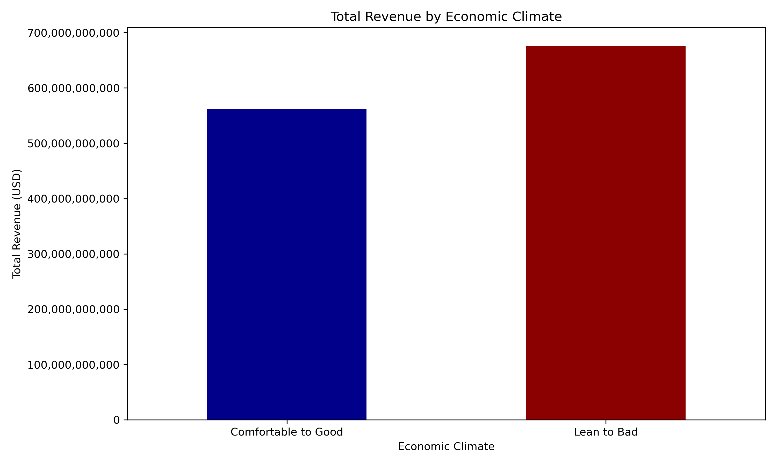
Movie performance
US CONSUMERS FIND THE TIME/MONEY FOR THE MOVIES IN BOTH GOOD AND BAD ECONOMIC TIMES
Notes:
More time in Lean to Bad
Key Findings
There is no clear relationship between the economic factors and movie profitability/ROI
In fact, mean revenue is higher during ‘Lean to Bad’ times
Note: Revenue is being reported on the first genre listed for any multi genre film (what % of the dataset was multi-genre)

Slide 11
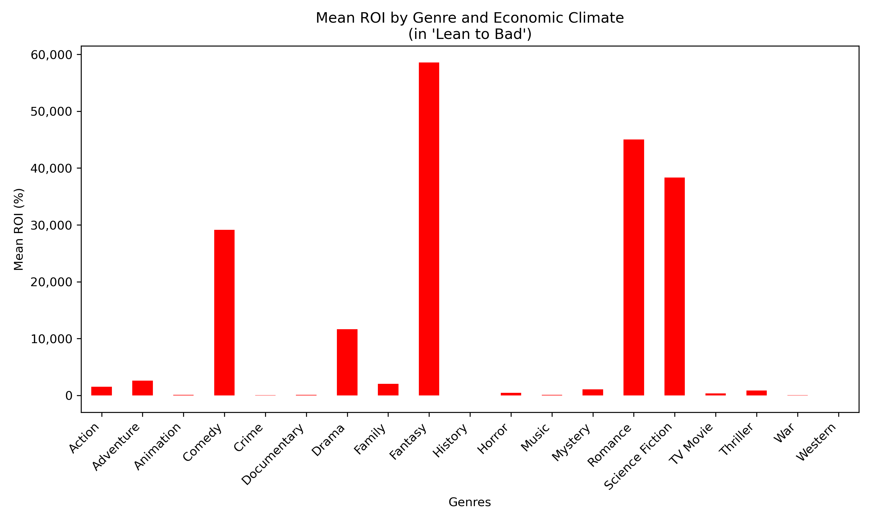
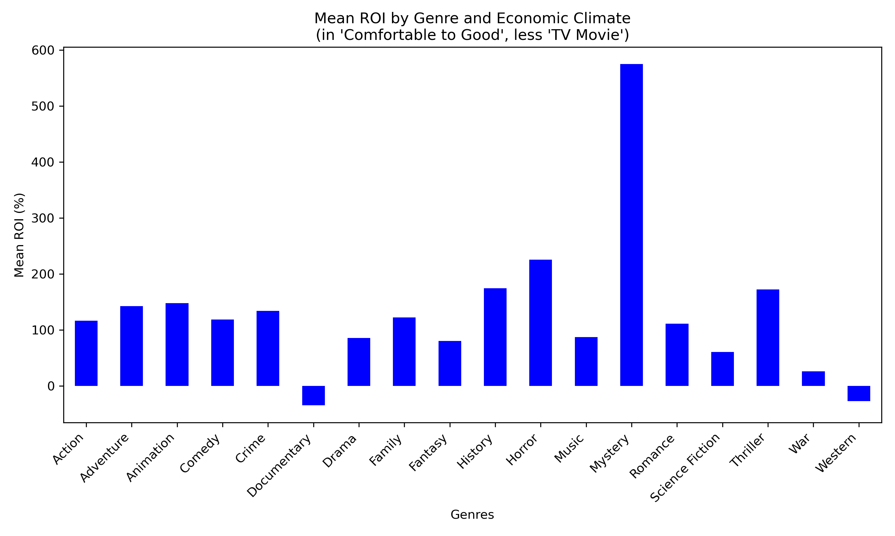
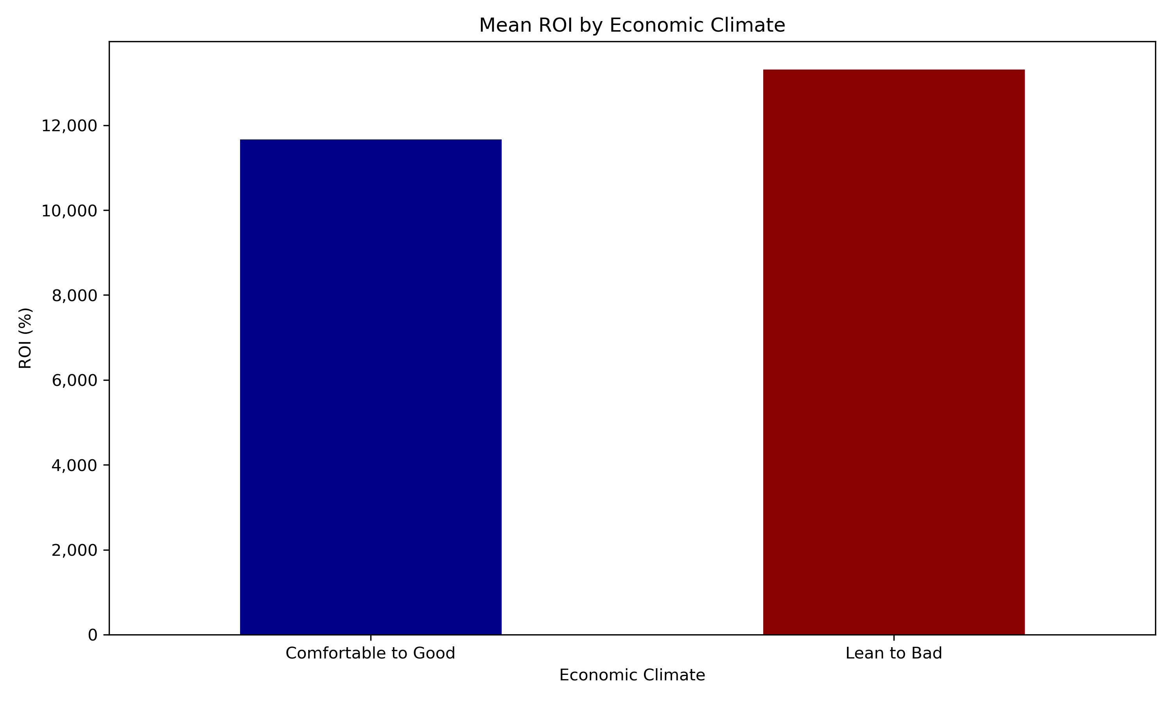
Movie performance
Note: Layered visuals for right charts. View in show; click to advance .
ROI IS HIGHER DURING CHALLENGING ECONOMIC TIMES; GENRES INDICATE CONSUMER DESIRE FOR ESCAPISM
Genres like Fantasy, Science Fiction, Romance, and Comedy are
better bets for ROI during tough economic times.
Notes:
Key Findings
Mean revenue is higher during tough economic times but mean ROI is lower relative to period of upturn (attributed to cost of production? Inflation?)
Some genres are better bets in lean times; Action, Comedy, Horror, Musicals have a much better ROI during economic downturns

Slide 12
Models: Outcome
ADABOOST
Random forest
Logistic regression
DECISION TREE
Accuracy: 0.40
Precision: 0.18
Not ideal for classification of high dimensional data
Accuracy: 0.80
Precision: 0.83
Most ideal for multi class target and high dimensional dataset. Handles non-linearity well.
Accuracy: 0.78
Precision: 0.79
Effective for multi-class classification with some caution around containing complexity
Accuracy: 0.99
Precision: 0.99
Easy to interpret but there is a risk for overfitting. Tuning needed; data leakage likely
K-NEARESt NEIGHBORS (knn)
Accuracy: 0.65
Performed poorly with high dimensional data
Linear regression
MSE: 43298644487.10
R2S: -0.08
Performed poorly with high dimensional data
Notes:
Failures (ADA, KNN) for some of the initial models used led us to explore other models (Random Forest, Logistic Regression)
Decision Tree: There is a question there still; .99 accuracy warrants further investigation

Slide 13






SUMMARY
“Nice F****** Model!” Beetlejuice (1988)
Random Forrest and Logistic models proved most successful with the non-linear relationship in the dataset
Economic factors were not proven strong in predicting movie profitability/ROI
Features like Genre were more effective in predicting movie success
Further analysis is warranted in understanding predictive strength of all individual features
Notes:
Breakfast at Tiffany (Peta)
The Matrix (Kalvin)
Wizard of Oz (Odele)
Beetlejuice (Vadim)
---------- (Eric/TBD)
Cruella (Funda/TBD)

Slide 14
Problems encountered
Exploratory Data Analysis (EDA):
Understanding the economic data (without a SME) and selecting which datasets to use
How to get the monthly reporting to connect to individually released movies
How genres are classified
Initial challenges with what to do with the null records
Encoding:
Saw poor performance using One Hot encoder and switched to label encoder to course correct.
Switching simplified the model and reduced complexity for the target
Identifying data leakage
Notes:
Note: We took a balanced approach in exploring multiple types of models which means that we will run into issues like data leakage
Exploratory Data Analysis (EDA): Visualize and understand data distributions and relationships between key variables.
Understanding the data without a SME (economist)
Selecting which economic datasets to use
How to get the monthly reporting to connect to individually released movies
How genres are classified - initial challenges with what to do with the null records
Encoding: Convert categorical variables into numerical formats for the model to process.
Had to switch encoder from One hot to label encoder. Saw poor performance using One Hot and then switched to course correct. Switching to label encoding simplified the model and reduced computational complexity, especially with high-cardinality categorical features.
High Cardinality: One-hot encoding can create too many columns if there are many unique categories. Label encoding reduces the dimensionality by converting categories into numerical labels.
Ordinal Nature: If the categories have a natural order (e.g., low, medium, high), label encoding preserves this order, while one-hot encoding does not

Slide 15

Future considerations
“The important thing is to never stop questioning.” Interstellar (2014)
Gather more diverse economic data and engage an economist to interpret that data
Additional analysis to determine the weight of individual features in predicting ROI and movie success
Notes:
Future considerations:
Gather more diverse economic data and engage an economist to interpreted that data.
Do some genres do better during tough economic times? Leverage group by on genre with mean on ROI, Group by genre and economic, sum on ROI

Slide 16





THANK YOU
Project II
Group 10
GitHub Repository

